Slide 1

CS-312 Artificial Intelligence
Week 06

Slide 2
Organization of Lecture
Propositional Calculus
Set of Equivalence Relation or Laws
Rules of Inference
First Order Logic (FOL)
Unification Algorithm in A.I

Slide 3
Propositional Logic
Propositional logic is a branch of logic that deals with propositions,
Proposition is a declarative statement that can be either true or false but cannot be both at the same time.
In AI propositions are those facts or conditions, regarding a particular situation or fact in the world.
It is the simplest form of logic used to represent knowledge and reason about it.
.

Slide 4
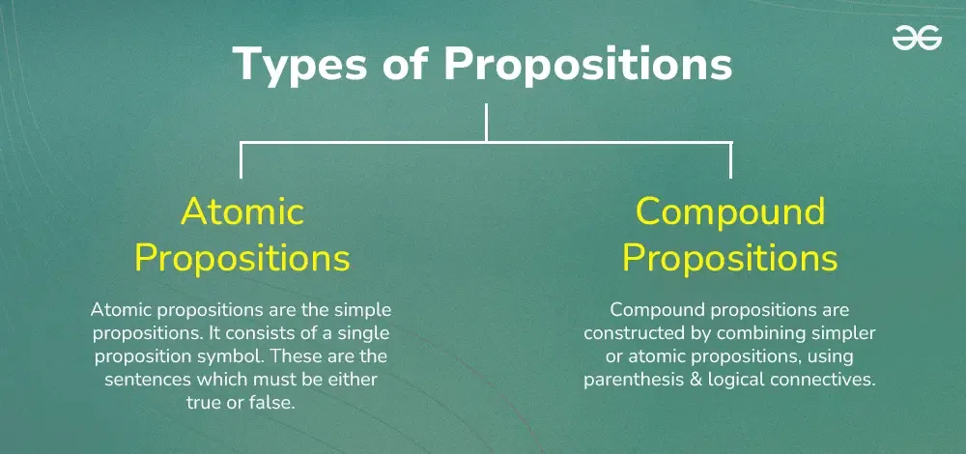
Propositional Logic

Slide 5
Propositional Logic
Examples of Propositions:
"It is raining."
"The light is on."
"Ali is a student."
Each of these can be represented by a single letter:
Let P = "It is raining"
Let Q = "The light is on"
Let R = "Ali is a student"
All these are atomic propositions.

Slide 6
Propositional Logic
Logical Connectives:
Connectives are used to combine atomic propositions to form compound propositions.
AND ( ∧ ): True if both propositions are true.
OR ( ∨ ): True if at least one proposition is true.
NOT ( ¬ ): Negates the truth value of a proposition.
IF-THEN ( → ): True unless the first proposition is true and the second is false.
IF AND ONLY IF ( ↔ ): True if both propositions have the same truth value.
Parentheses for grouping: (, )
Notes:
"If P is true, then Q must also be true.

Slide 7
Propositional Logic
AND ( ∧ ): True if both propositions are true. Example: "It is raining AND it is cold." → P ∧ Q
OR ( ∨ ): True if at least one proposition is true. Example: "It is raining OR it is sunny." → P ∨ Q
NOT ( ¬ ): Negates the truth value of a proposition. Example: P=“It is raining”. "It is NOT raining." → ¬P
IF-THEN ( → ): True unless the first proposition is true and the second is false. Example: "If it rains, then the ground is wet." → P → Q
IF AND ONLY IF ( ↔ ): True if both propositions have the same truth value. Example: "The heater is on IF AND ONLY IF the temperature is low."→ P ↔ Q.
These compound propositions help in building more expressive logical statements and rules.
Notes:
-> implies to

Slide 8
Student Activities
1. Identify the correct logical operator:
a) If the sun shines, we will go outside → ______
b) The alarm is set and the door is locked → ______
2. Convert the following sentences into propositional logic:
a) "If I study, I will pass the test"
b) "It is raining or it is snowing"
c) "You can drive if and only if you have a license"
3. Create your own examples using ¬, ∧, ∨, →, ↔
Notes:
Implication (→)
AND (∧)
2, a) S → P
b) R ∨ N
c) D ↔ L

Slide 9
Equivalence Laws in Propositional Logic
(P, Q, R are propositional variables)
1. Commutative Laws
P ∧ Q ≡ Q ∧ P
P ∨ Q ≡ Q ∨ P
These laws say the order doesn’t matter for AND (∧) and OR (∨). Just like 2 + 3 = 3 + 2.
Example:
It is cold AND raining” is the same as “It is raining AND cold.
It is cloudy OR it is raining” is the same as “It is raining OR it is cloudy

Slide 10
Equivalence Laws in Propositional Logic
2. Associative Laws
(P ∧ Q) ∧ R ≡ P ∧ (Q ∧ R)
(P ∨ Q) ∨ R ≡ P ∨ (Q ∨ R)
When combining 3 statements with AND or OR, the grouping doesn’t affect the result. Think: (A + B) + C = A + (B + C)
Examples:
(Raining AND Cold) AND Windy” = “Raining AND (Cold AND Windy)
(Cloudy OR Raining) OR Thunder” = “Cloudy OR (Raining OR Thunder)

Slide 11
Equivalence Laws in Propositional Logic
3. Double Negation
¬(¬P) ≡ P
If you negate a statement twice, you get back the original. Saying “It’s not true that it’s not raining” just means “It is raining.”

Slide 12
Equivalence Laws in Propositional Logic
4. De Morgan’s Laws
¬(P ∨ Q) ≡ ¬P ∧ ¬Q
Example: It is NOT (raining OR cloudy)” = “It is NOT raining AND it is NOT cloudy.
¬(P ∧ Q) ≡ ¬P ∨ ¬Q
Example: It is NOT (raining AND cold)” = “It is NOT raining OR it is NOT cold.
These laws show how to distribute a NOT over AND/OR:
“Not (P or Q)” means “not P and not Q.”
“Not (P and Q)” means “not P or not Q.”

Slide 13
Equivalence Laws in Propositional Logic
5. Absorption Laws
P ∧ (P ∨ Q) ≡ P
Example: It is raining AND (raining OR cloudy)” is also just “It is raining.
P ∨ (P ∧ Q) ≡ P
Example: It is raining OR (raining AND cloudy)” is just “It is raining.
These help simplify expressions by absorbing the second part:
If P is true, “P AND (P OR Q)” is just P.
If P is true, “P OR (P AND Q)” is also just P

Slide 14
Equivalence Laws in Propositional Logic
P | ¬P | P ∧ ¬P
1 | 0 | 0
0 | 1 | 0
6. Law of Contradiction
P ∧ ¬P ≡ False
This law says a statement and its negation can never be true at the same time.
Always false. You can't say “It is raining AND it is not raining” at the same time.

Slide 15
Equivalence Laws in Propositional Logic
7. Law of Excluded Middle
P ∨ ¬P ≡ True
This means either a statement is true or its negation is true—there's no third option.
Always true. It's either raining or it's not—one must be correct.
P | ¬P | P ∨ ¬P
1 | 0 | 1
0 | 1 | 1

Slide 16
Equivalence Laws in Propositional Logic
8. Law of Idempotency
P ∧ P ≡ P
P ∨ P ≡ P
Repeating the same statement with AND gives the same result.
P stays the same.
Example: “It is raining AND it is raining” is no different from just saying “It is raining.”
P | P ∧ P
1 | 1
0 | 0
Notes:
i-dem-po-tency

Slide 17
Inference Rules
Modus Ponens:
The Modus Ponens rule is one of the most important rules of inference, and it states that if P and P → Q is true, then we can infer that Q will be true. It can be represented as:
Example:
Statement-1: "If I am sleepy then I go to bed" ==> P→ Q Statement-2: "I am sleepy" ==> P Conclusion: "I go to bed." ==> Q. Hence, we can say that, if P→ Q is true and P is true then Q will be true.
Notes:
Mo-dus po-nens

Slide 18
Inference Rules
Modus Tollens:
The Modus Tollens rule state that if P→ Q is true and ¬ Q is true, then ¬ P will also true. It can be represented as:
Example:
Statement-1: "If I am sleepy then I go to bed" ==> P→ Q Statement-2: "I do not go to the bed."==> ~Q Statement-3: Which infers that "I am not sleepy" => ~P

Slide 19
Propositional Logic - Limitations
Propositional logic can only represent the facts, which are either true or false.
Not sufficient to represent the complex sentences or natural language statements.
"Every student in the room raised their hand.“ Propositional Logic would require a separate symbol for each student, like:
P1 = "Ali raised hand", P2 = "Sara raised hand", ...
Has very limited expressive power PL - cannot express "some", "all", "none", "every" types of statements. Consider the following sentence, which we cannot represent using PL logic.
"Some humans are intelligent", or
“All humans are mortal."
Notes:
Cannot handle degrees of truth like:
"Ali is probably a student."
"Ali might be a good student."
These require probabilistic or fuzzy logic.

Slide 20
Propositional Logic - Limitations
Lacks variables, so general rules can't be formed.
Example: “If a person is hungry, they eat” → not possible in PL
Is static — it doesn’t handle dynamic facts.
Example: “It is raining now but will stop later” → not possible in PL
No Internal Structure of Propositions:
PL treats entire statements as atomic.
You can’t represent or reason about components within a statement.
Example: P = "Ali is a student“
Can't ask: Who is a student?
Notes:
-it states a specific fact rather than a rule that applies to multiple instances.
-fixed facts at a given moment and cannot express dynamic, time-dependent changes like

Slide 21
First Order Logic
First Order Logic (also called Predicate Logic or First Order Predicate Calculus) is a formal system used to describe the world in terms of:
Objects
Properties of objects (Predicates)
Relationships between objects
Quantified statements like "all", "some"
Notes:
Objects: Entities in the domain of discourse that the logic reasons about (e.g., people, places, things).
Properties of objects (Predicates): Characteristics or attributes that describe objects (e.g., isTall(Ali)).
Relationships between objects: Associations between two or more objects represented using predicates (e.g., Loves(Ali, Sara)).
Quantified statements like "all", "some": Logical statements that express generality or existence over objects in the domain using quantifiers like ∀ (for all) and ∃ (there exists).

Slide 22
First Order Logic
Whereas propositional logic assumes that a world contains facts, first-order logic, also called Predicate Logic or First Order Predicate Calculus, is a formal system (like natural language) that assumes the world contains
Objects: people, houses, numbers, theories, colors, games, wars, . . .
Relations: red, round, bogus, prime, multistoried . . ., brother of, bigger than, inside, part of, has color, occurred after, owns, comes between, . . .
Functions: father of, best friend, third inning of, one more than, end of . . .
Notes:
Relations may have multiple possible matches (or none).
One input → Multiple outputs possible
BrotherOf(Ali, Zain) → returns True if Ali is Zain's brother
Functions must return exactly one unique result. FatherOf(John) → returns David (a single object)
One input → One output

Slide 23
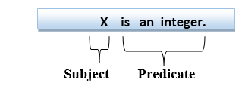
First Order Logic
First-order logic statements can be divided into two parts:
Subject: Subject is the main part of the statement.
Predicate: A predicate can be defined as a relation, which binds two atoms together in a statement.
Consider the statement: "x is an integer.", it consists of two parts, the first part x is the subject of the statement and second part "is an integer," is known as a predicate.

Slide 24
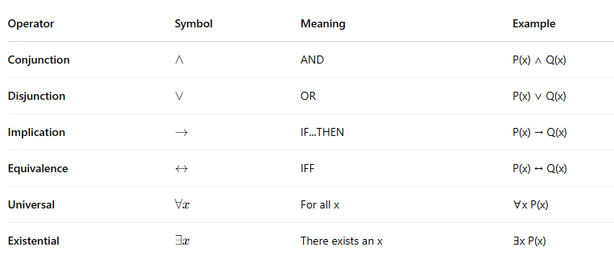
First Order Logic - Laws

Slide 25
First Order Logic – Laws with examples
Operator | Symbol | Meaning | Natural Language Example
Conjunction | ∧ | AND | "x is tall AND smart"
Disjunction | ∨ | OR | "x is tall OR smart"
Implication | → | IF...THEN | "If x studies, then x passes"
Equivalence | ↔ | IFF | "x is eligible IFF x is 18 or older"
Universal | ∀x | For all x | "All birds can fly"
Existential | ∃x | There exists x | "There is someone who won the prize"
Notes:
Conjunction: Both statements must be true for the whole statement to be true. Example: Let P(x) = x is a student, and Q(x) = x is punctual. P(x) ∧ Q(x): "x is a student AND x is punctual"
If x is both, the statement is true. If either is false, the whole is false.
Disjunciton: True if at least one of the statements is true. Example: P(x) ∨ Q(x) = "x is a student OR x is punctual“.
Implicaiton: P(x) → Q(x) = "If x studies, then x will pass“ (statement is only about if x studies then…, there is no implication of if x does not study)

Slide 26
First Order Logic - Quantifiers
Quantifiers in First-order logic:
A quantifier is a language element / symbol which specify the quantity (how many) of instances a statement applies to.
There are two types of quantifier:
Universal Quantifier, (for all, everyone, everything)
In universal quantifier we use implication "→".
∀x (Human(x) → Mortal(x)) “All humans are mortal.”
Existential quantifier, (for some, at least one).
In Existential quantifier we always use AND or Conjunction symbol (∧).
∃x (Student(x) ∧ Punctual(x)) “Some students are punctual.
Notes:
∀ (for all)
“Every citizen pays taxes.” → ∀x (Citizen(x) → PaysTaxes(x))
∃ (there exists).
“There is a person who knows AI.” → ∃x (Person(x) ∧ Knows(x, AI))

Slide 27
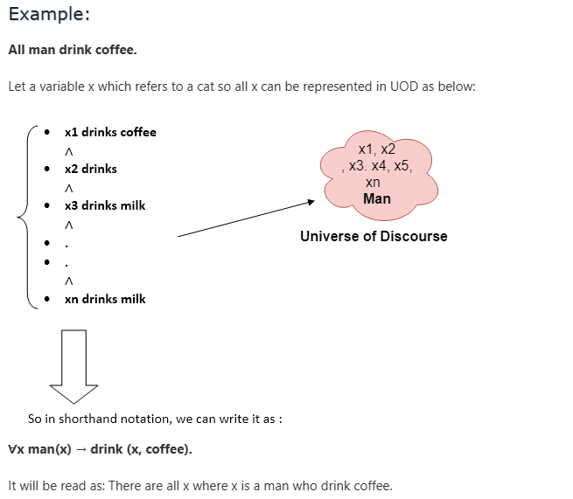
First Order Logic – Universal Quantifier
Let a variable x which refers to a man
Notes:
The Universe of Discourse is the set of all possible objects or entities that a variable (like x) can refer to in a logical statement.
x is a variable.
UoD = all people (or all students, or all humans) — depending on what you're talking about.
The statement means: → For every x in the UoD, if x is a boy, then x likes football.

Slide 28
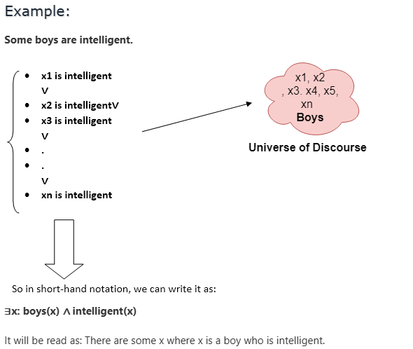
First Order Logic – Existential Quantifier
Notes:
∃ (there exists).

Slide 29
First Order Logic - Limitations
More Examples:
“Every citizen pays taxes.” → ∀x (Citizen(x) → PaysTaxes(x))
“There is a person who knows AI.” → ∃x (Person(x) ∧ Knows(x, AI))
All boys like football→ ∀x (Boy(x) → Like(x, football))
Some boys like football→ ∃x (Boy(x) ∧ Like(x, football))

Slide 30
Unification
Unification is a process of making two different logical atomic expressions identical by finding a substitution. i.e. suitable substitutions for their variables.
It takes two literals as input and makes them identical using substitution.

Slide 31
Unification
Conditions for Unification:
Predicate symbol must be same, atoms or expression with different predicate symbol can never be unified.
Likes(John, x)
Hates(John, x)
Number of Arguments in both expressions must be identical.
Likes(John)
Likes(John, x)
Unification will fail if there are two similar variables present in the same expression.
Likes(x, x)
Likes(John, Mary)
Notes:
Here, x must be equal to both John and Mary, which is not possible (unless John = Mary, which we don't assume). So unification fails.

Slide 32
Unification
Type | Notation / Format | Example
Variables | Start with lowercase or uppercase letters, typically X, Y, Z | X, Y, Z, x1, xPerson
Constants | Represent specific fixed objects, usually written as lowercase names or symbols | b, john, cat, monday
Functions | Typically lowercase and applied to arguments | f(X), g(b), fatherOf(X)
Predicates | Capitalized, usually name a property or relation | P(x), Loves(John, x)
Notes:
Here, x must be equal to both John and Mary, which is not possible (unless John = Mary, which we don't assume). So unification fails.

Slide 33
Unification
Variables: are placeholders that can be substituted. Examples: X, Y, Z, x
Constants: are fixed entities or symbols. Examples: b, ali, 5, blue, john
Functions: are built from constants/variables and return terms. Examples: f(X), g(b), age(ali)
Notes:
Here, x must be equal to both John and Mary, which is not possible (unless John = Mary, which we don't assume). So unification fails.

Slide 34
Unification
p(b, X, f(g(Z))) and p(Z, f(Y), f(Y))
Term | Type | Why?
b | Constant | It's a lowercase fixed symbol
X, Y, Z | Variables | Uppercase letters (placeholders)
f(g(Z)) | Function | Function f applied to result of g(Z)
f(Y) | Function | Function f applied to variable Y
Notes:
Here, x must be equal to both John and Mary, which is not possible (unless John = Mary, which we don't assume). So unification fails.

Slide 35
Unification
Unify: Knows(John, x) and Knows(y, z)
Substitution: { y/John, z/x }
Result: Both expressions become Knows(John, x)
Notes:
Here, x must be equal to both John and Mary, which is not possible (unless John = Mary, which we don't assume). So unification fails.

Slide 36
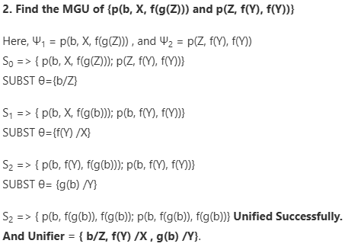
Unification
{term / variable}
The variable (right side) is replaced.
The term (left side) is what replaces it
Notes:
We never replace constants. Constants like b, 5, or Ali are fixed — they represent actual values.
We only replace variables to match structures.
Variables are like placeholders (X, Y, Z) that can be substituted.
The goal is to find a substitution that makes two expressions identical.
MGU=Most general unifier

Slide 37


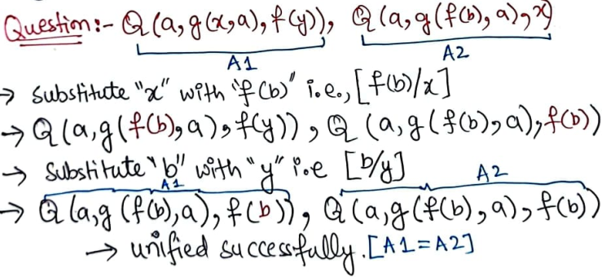
Unification Algorithm in A.I
Substitute: [f(b)/x]
Q(a, g(f(b), a), f(y))
Q(a, g(f(b), a), f(b))
Substitute: [b/y]
Q(a, g(f(b), a), f(b))
Q(a, g(f(b), a), f(b))
Q(a, g(f(b), a), f(b))

Slide 38
Forward Chaining
It follows a bottom-up strategy
It is the process of reaching a decision based on known facts or information, beginning with the initial state and progressing to the target state.
The forward-chaining method is also known as data-driven because we achieve our objective by employing available data.
The forward-chaining method is widely used in expert systems such as CLIPS, business rule systems, and manufacturing rule systems.
Notes:
CLIPS stands for:
C Language Integrated Production System
It is a public domain expert system tool developed by NASA.

Slide 39
Forward Chaining
Forward chaining is a data-driven inference technique where reasoning starts with the known facts, and uses inference rules to extract more data, moving toward a conclusion or goal.
It’s like building a story from facts to conclusions.
Concepts:
1 Start with known facts 2 Apply rules whose conditions match those facts 3 Derive new facts (conclusions) 4 Repeat this process until the goal is reached, or no new facts can be inferred

Slide 40
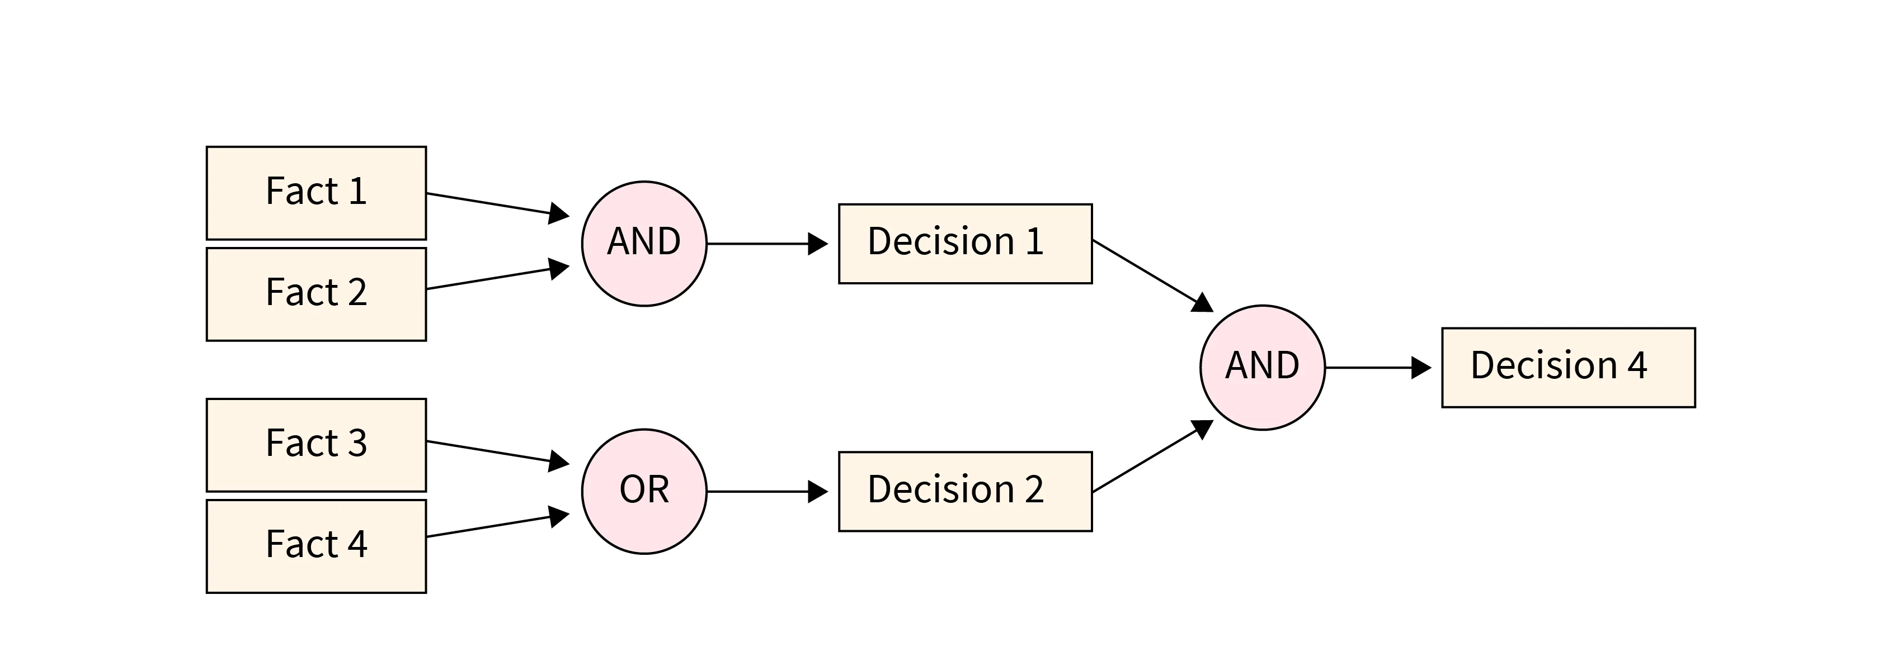
Forward Chaining

Slide 41
Forward Chaining
Let us say we have the following:
Fact 1: A dog is up for adoption through person A.
Fact 2: Person B is looking for a dog.
Inference rule: If a dog is up for adoption and someone is looking to adopt it, that person is free to adopt it.

Slide 42
Example
Facts given:
-Fact 1: Patient has a high fever
-Fact 2: Patient has a cough
-Fact 3: Patient has shortness of breath
Rules
-Rule 1: IF patient has high fever AND cough → THEN possible flu
-Rule 2: IF possible flu AND shortness of breath → THEN possible pneumonia
-Rule 3: IF possible flu AND NOT shortness of breath → THEN mild flu, rest recommended
Notes:
[Start]→ [Fact 1?]→Yes -> [Fact 2?] → Yes → [Rule 1:Possible Flu] → [Rule 2?] →Yes→ [Possible Pneumonia]
| | |
No -> [End:] No──> [End] No→ [Mild Flu]

Slide 43
Backward Chaining
It is referred to as a top-down strategy.
It acts in the reverse direction to forward chaining.
The top-down approach involves using decisions or goals to reach the facts i.e. a goal-driven approach.
a list of objectives determines which rules are chosen and used.
The backward-chaining method is used in game theory, automatic theorem-proving techniques, prove assistants and other artificial intelligence uses.

Slide 44
Backward Chaining
Backward chaining is a reasoning technique in AI (especially in expert systems)
where the system starts with a goal or hypothesis and works backward to see
if facts and rules support it.
Concepts:
Start with a goal.
Look for rules where this goal is in the THEN part.
Check if the IF part of those rules is satisfied by existing facts.
If not, treat the unsatisfied conditions as new sub-goals.
Repeat this until:
You reach known facts (success), or
No rules or facts can support the goal (failure)

Slide 45
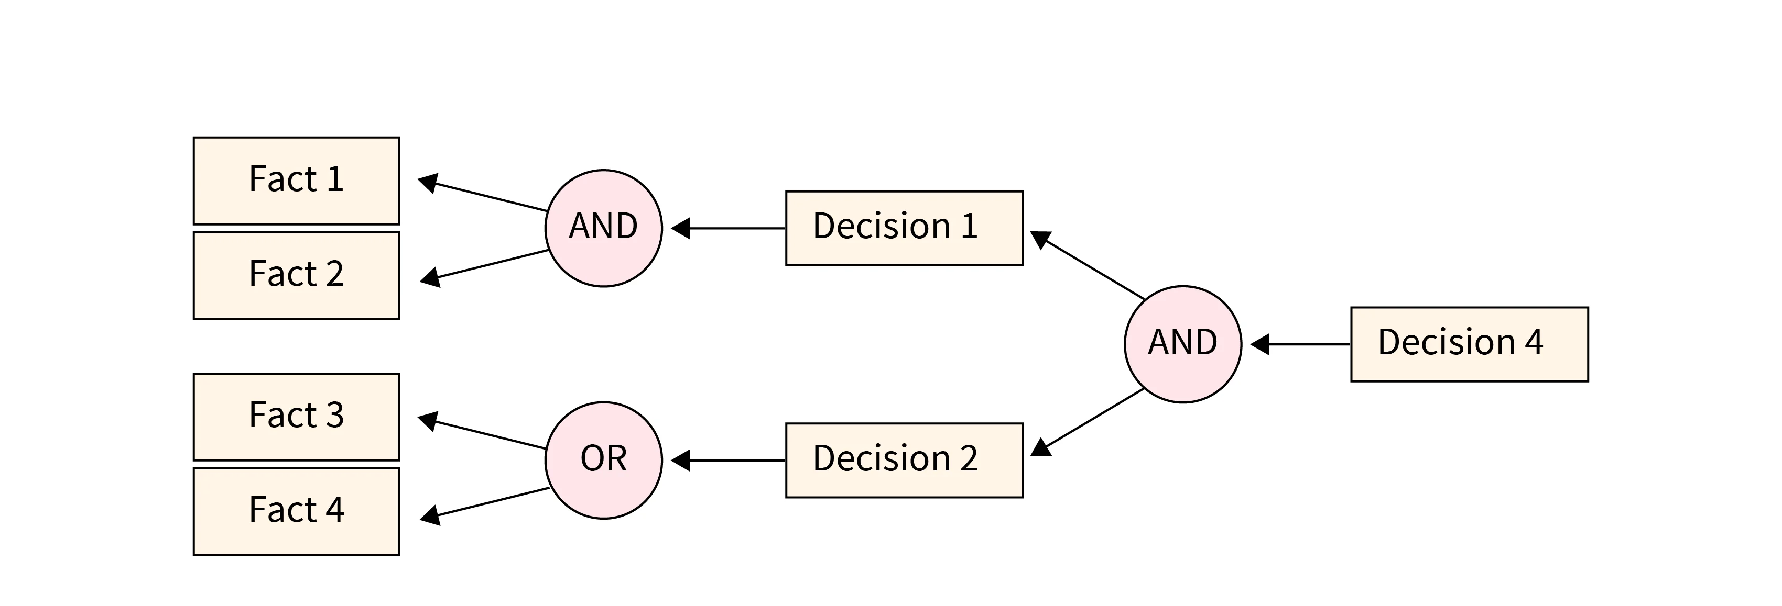
Backward Chaining

Slide 46
Backward Chaining
Let us take the same example.
Decision/Goal: Person B adopts a dog.
Fact 1: A dog is up for adoption from Person A.
Fact 2: Person B is looking for a dog.
Inference rule: If a person wants to adopt a dog, he can if there is any up for adoption.

Slide 47
Example
Rules
-Rule 1: IF patient has high fever AND cough → THEN possible flu
-Rule 2: IF possible flu AND shortness of breath → THEN possible pneumonia
Facts given:
-Fact 1: Patient has a high fever
-Fact 2: Patient has a cough
-Fact 3: Patient has shortness of breath
Start Node: Possible Pneumonia
Goal Node: All conditions are confirmed (goal achieved)
Notes:
[Start Goal: Possible Pneumonia] → [Is there a Rule to deduce Possible Pneumonia?] → [Check Rule R2:]→ [Is Shortness of Breath true?] → Yes [Is Possible Flu true?]→ Yes [Check Rule R1]→
[Is High Fever true?]→ Yes [Is Cough true?] → [Possible Flu confirmed]→ [Possible Pneumonia confirmed]→ [Diagnosis Complete]

